Slide 1
EN 410 Energy Management
Gurubalan Annadurai
guru.a@iitb.ac.in

Slide 2
Recap
MT and R process – Elements, steps
Regression analysis
CUMSUM Technique
Energy benchmarking

Slide 3
Energy Billing
Electricity
Fuel
Steam
Cold/hot water

Slide 4
Electricity billing rate
Unlike other utilities (like fuel) – Charges standard and depends on demand, time, consumer type
Electric billing = Customer charge + Electric charge + Fuel adjustment
Flat rate
Billing according to the amount of electricity
Fixed customer charge
Mostly applied to residential and commercial users
Lower billing rate when compared to industries
Lower billing rate for a fixed small amount of usage – promotes optimum using and encourage energy efficient equipment or appliances
Flat seasonal rate – Similar to flat rate but different electric charge.
E.g. summer electric charge due to substantial use of air conditioners

Slide 5
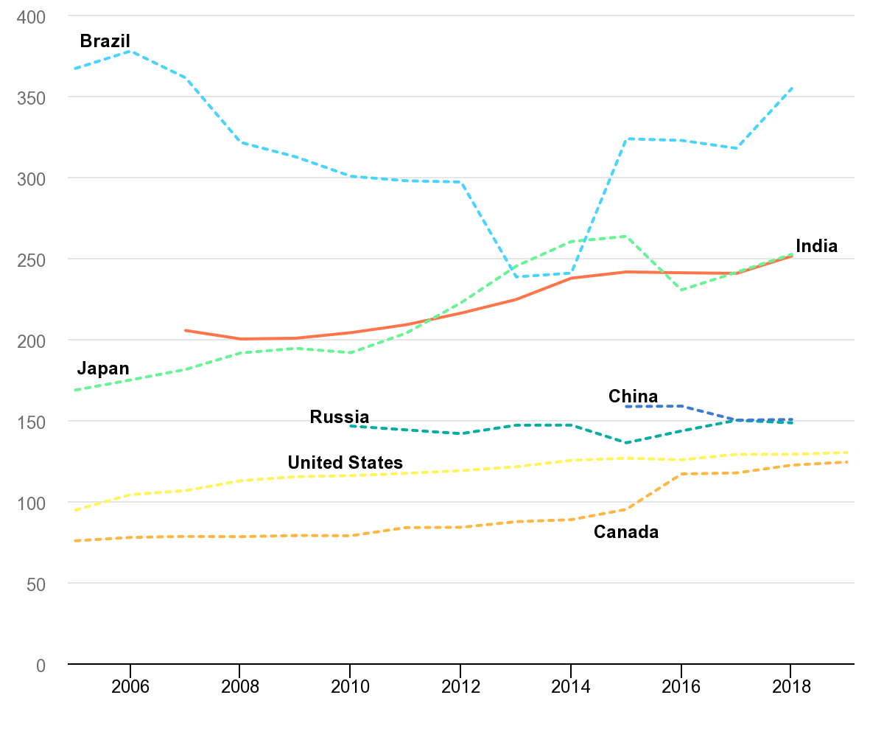
Residential electricity prices
USD PPP per MWh
Variation due to fuel source of countries
Year

Slide 6
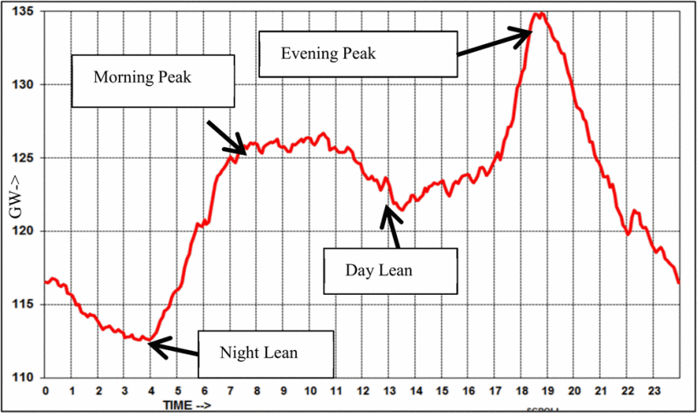
Time of use rate
Depends of the day
Reducing the peak load and thereby reducing in investing new power plant while increasing trend of demand
Scheduling the operation (e.g., setting up timer for dishwasher, washing machine etc.)

Slide 7
Voltage based billing
Lower charge for the industry receives electricity at the transmission voltage rate (>50000 V)
Maintenance charge for distribution and transformers

Slide 8
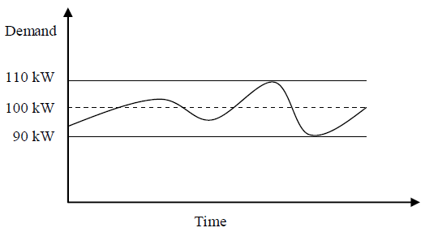
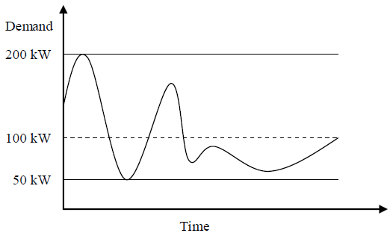
Demand Billing
Additional charges for peak demand in addition to utility charge
Load factor
Ratchet rate – Certain % ( generally 50) of peak demand of previous 11 or 12 months
Facility A: The utility charges this facility
(0.80)(110 kW)($10/kW) = $880
per month for demand billing.
Facility B: The utility charges this facility
(0.80)(200 kW)($10/kW) = $1600
per month for demand billing.

Slide 9
Demand Billing
An industrial facility operating 24 hours a day through the week consumes 2.8 million kWh of electricity in April. The demand varies between 3000 kW and 5500 kW during this month. The electrical load supplied by the utility has fluctuated between 2000 kW and 6400 k during the previous 11 months. The demand billing for a given month is based on 50% of peak demand in the previous 11 months. The unit price of electricity is $0.12/kWh and the demand charge is $13/kW. Determine the load factor, consumption charge and percent of demand charge for the month of April.

Slide 10
Economics
Any energy efficiency or conservation technique is evaluated by economics in industry
Capital or Initial cost
Operating cost
Maintenance cost
Scrap value

Slide 11
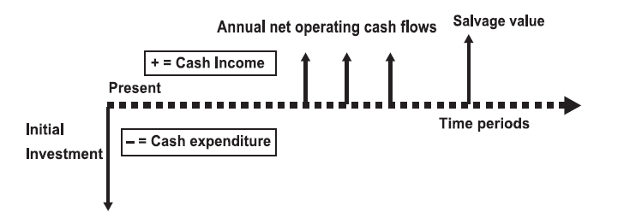
Cash flow diagram
Expenditures: Negative (downward) arrows
Incomes: Positive (upward) arrows
Net income form measure
Operating and Maintenance costs

Slide 12
Metrics of economic analysis
Time value of money
Life cycle cost
Net present value
Levelized annual value
Payback period

Slide 13
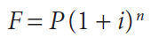
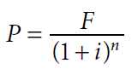
Time value of money
Value of money changes with interest and inflation
Simply subtracts the investment with savings during the timeline of project neglects the time value of money
Compound interest
Relation between present and future values of money
i interest rate or discount rate
n number of time period
P present value of money
F future value of money

Slide 14
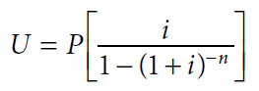
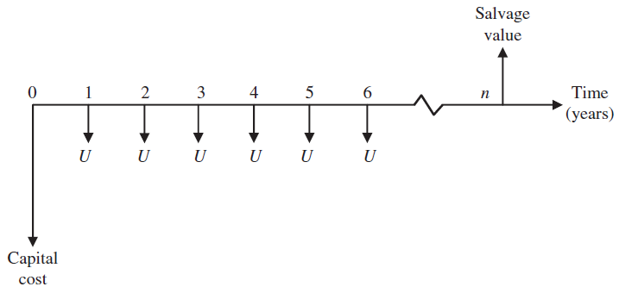
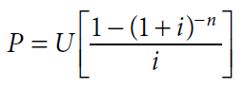
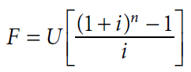
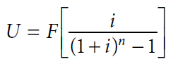
Time value of money - Uniform series amount
U uniform series amount: The periodic income or expenditure

Slide 15
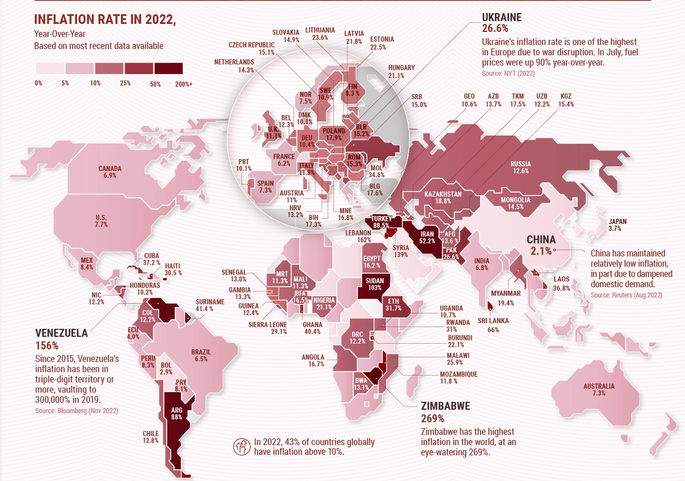
Global inflation

Slide 16
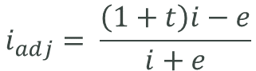
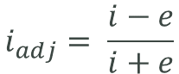
Adjusted interested rate due to inflation (e) and taxation (t)
Only Inflation
Inflation and taxation
$$i_{adj}= \frac{i−e}{i+e}$$
$$i_{adj}= \frac{\left(1+t\right)i−e}{i+e}$$

Slide 17
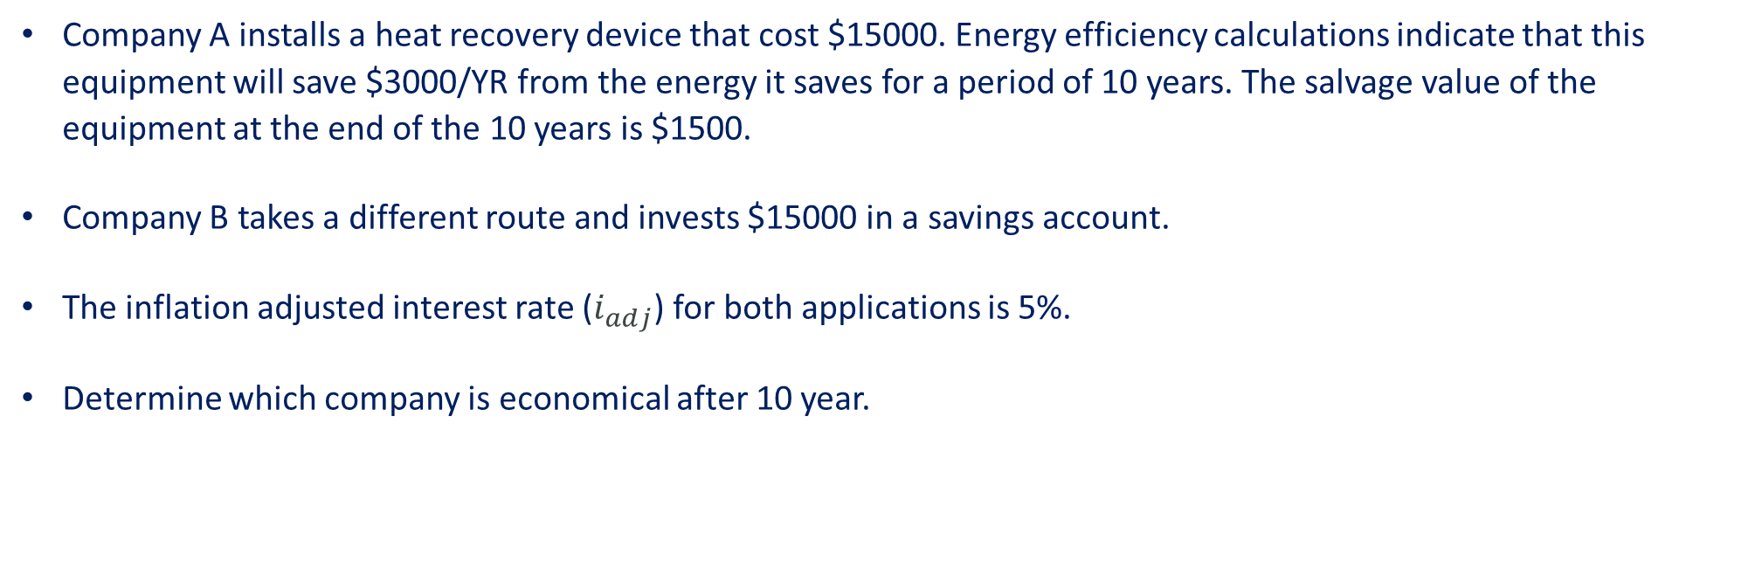
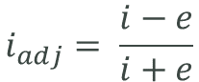
Energy economy
Company A installs a heat recovery device that cost $15000. Energy efficiency calculations indicate that this equipment will save $3000/YR from the energy it saves for a period of 10 years. The salvage value of the equipment at the end of the 10 years is $1500.
Company B takes a different route and invests $15000 in a savings account.
The inflation adjusted interest rate ($i_{adj}$) for both applications is 5%.
Determine which company is economical after 10 year.
$$i_{adj}= \frac{i−e}{i+e}$$

Slide 18
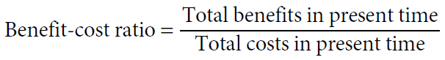
Life cycle cost
Converting all the costs into one value which is easy for comparison across the projects
Net present value (NPV) method – Converting all the expenses and benefits over the life cycle into present value, P
Leveled annual value method – useful to compare the projects with different timeline

Slide 19
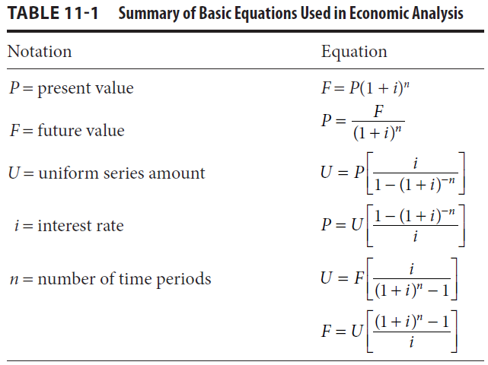
Net present value (NPV)
A steam boiler is to installed in an existing gas turbine power plant. The initial cost of the boiler is $50000. It is estimated that the boiler will save $10000/yr from the fuel it saves. It will take $2000/yr to operate and maintain the boiler. The system requires major cleaning after 6 year for a cost of $7000. The lifetime of the boiler is 12 year and the salvage value is $3000. The inflation adjusted interest rate for both applications is 4%.
Draw the cash flow diagram
Determine the net present value (NPV)
Recalculate the NPV without considering inflation and interest
Estimate the benefit to cost ratio
What is the levelized annual value of this project?

Slide 20
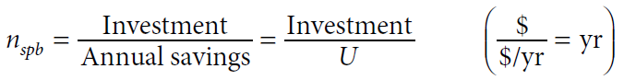
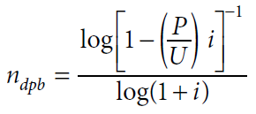
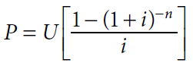
Payback period
Significantly lower than project timelines
Two to three years maximum
Simple payback period
Discounted payback period which includes the time value of money

Slide 21
Payback period of building insulation
A new insulation is selected for a building as an energy efficiency measure of building which can reduce the heat/cold losses from the building. A natural gas boiler is used in winter for heating and an air-conditioning system is used in summer for cooling. It is estimated that the insulation will reduce the natural gas consumption by 7500 therm in winter and electricity consumption by 50000 kWh in summer. The insulation costs around $60,000 including the material and labour. The unit cost of natural cost and electricity is $1.2/ therm and $0.11/kWh. The interest rate is 6%. Estimate the discounted and simple payback periods.
(Note: 1 therm = 100,000 Btu, 1 BTU = 1055 J)

Slide 22
Energy performance contractor
Energy service companies - ESCO
Assessment, design, construction, installation, management service, financing
Payment on performance
Generally risks associated projects taken by ESCO
Fee type – Fixed fee, Shared savings and Guaranteed savings

Slide 23
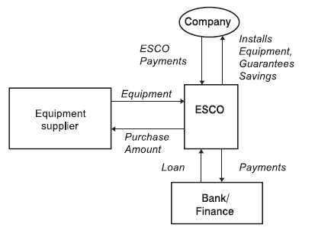
Role of ESCO
Identify the savings potential
Finical own resources or banking
Equipment, personal training for operation and maintenance, energy efficient practices
Monitoring of operation and energy savings
Measurement and savings verification

Slide 24
Recap
Cash flow diagram
Time value of money
Net present value
Levelized annual value
Payback period
Role of ESCO

Slide 25
References
K. Gaur, H. Kumar, R. P. K. Agarwal, K. V. S. Baba and S. K. Soonee, "Analysing the electricity demand pattern," 2016 National Power Systems Conference (NPSC), 2016, pp. 1-6, doi: 10.1109/NPSC.2016.7858969.
https://www.visualcapitalist.com/mapped-which-countries-have-the-highest-inflation/

